Slide 1

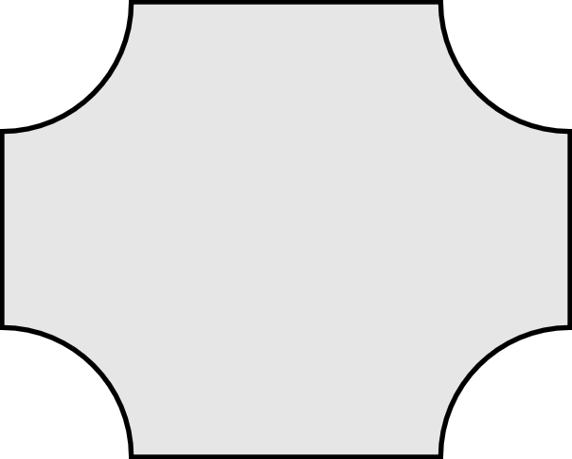
 | MAKING LINKS – 4 CORNERS
Make links between 3 or more of the concepts on the grid and write a sentence that links them.
Write a Number or letter in the corner to show the link. Each concept can be used up to 4 times.
For Example:

