Slide 1





















SUCCESS IN SOCIAL SCIENCES
PARTICIPATION
INDEPENDENT STUDY
REVISION
Revisit previous topics
Wider reading
Keeping up with current events
Practise exam style questions
Summarise your class notes
In order to be successful in the social sciences you need to be proactive in your studies. Using your prep and non-contact time effectively to support your studies. These are just some of the things you can do.
Revision takes place when you are preparing for an assessment or test. It happens after the teaching and learning of content has happened.
Prioritise
Brain Dump
Fill Gaps
Quiz yourself
Exam Practise
Reflect and review
Self quiz on content
Pre- read on future content
Make links between topics
Ask for Help if you need it
STUDY
LEARNING
SUCCESS
IN SOCIETY
LAW
SOCIOLOGY
POLITICS

Slide 2

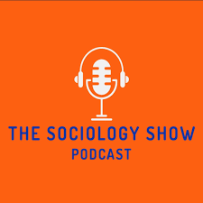


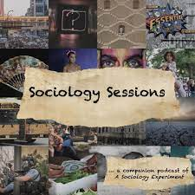


INDEPENDENT STUDY IN SOCIOLOGY
WHAT CAN YOU DO FOR INDEPENDENT STUDY?
complete tasks in your unit companion from previous topics
Quiz yourself using online systems such as carousel learning or Seneca
make your own revision guide – 1 page summaries
practice exam style questions
Review content through brain dumps to check for gaps in knowledge.
wider reading and research to find more sociological studies and evidence
Listen to podcasts relating to the course topics
Catch up on any missing class work or notes.
Review lecture videos of previous and upcoming topics.
Remember to use the three colours system to show:
        What you have remembered and recalled.
        What you needed to look up in notes or research.
        What you needed to ask your teacher.

