Slide 1
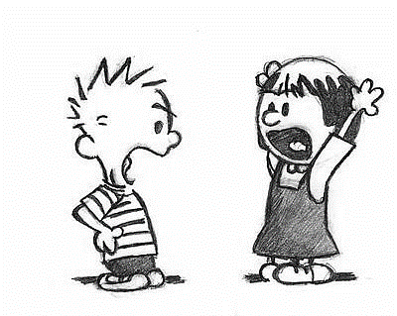
I respectfully disagree because…
Regardless of your objections
That might be so but….
You are not listening,
But don’t forget that….
But what about
But have you considered….
I believe that…

