Slide 1
ARGUMENT ESSAY
ITEM – See Question Sheet
Command Words | Topic | Focus | Evaluation Stem
Turn the question binary [yes/no question]
Context
Background
Definition
Trend
Content
Sentence Starter | FOR | AGAINST
1
2
3
4
30 mark only

Slide 2
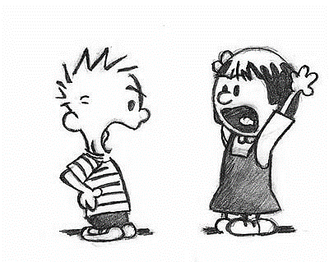
I respectfully disagree because…
Regardless of your objections
That might be so but….
You are not listening,
But don’t forget that….
But what about
But have you considered….
I believe that…

